Slide 1
Server/cluster/cloud terminology and introduction to HPC
(AKA “My computer can’t handle all of this data”)

Slide 2
First, the “basics”…

Slide 3
Image source: http://www.liquiditybook.com/liquiditybook-completes-global-migration-to-amazon-web-services-data-centers/
Notes:
This is an example of an amazon server room, and I think that it is helpful to remember that we are talking about actual, physical things when we are talking about “the cloud” and “server clusters”. Even though we don’t usually see these rooms, it is helpful to remember that the cloud is really just a huge number of networked computers. Of course, it gets very complicated in how data are handled between and within all of these computers, but when it comes down to it, we really are talking about physical pieces of equipment.

Slide 4
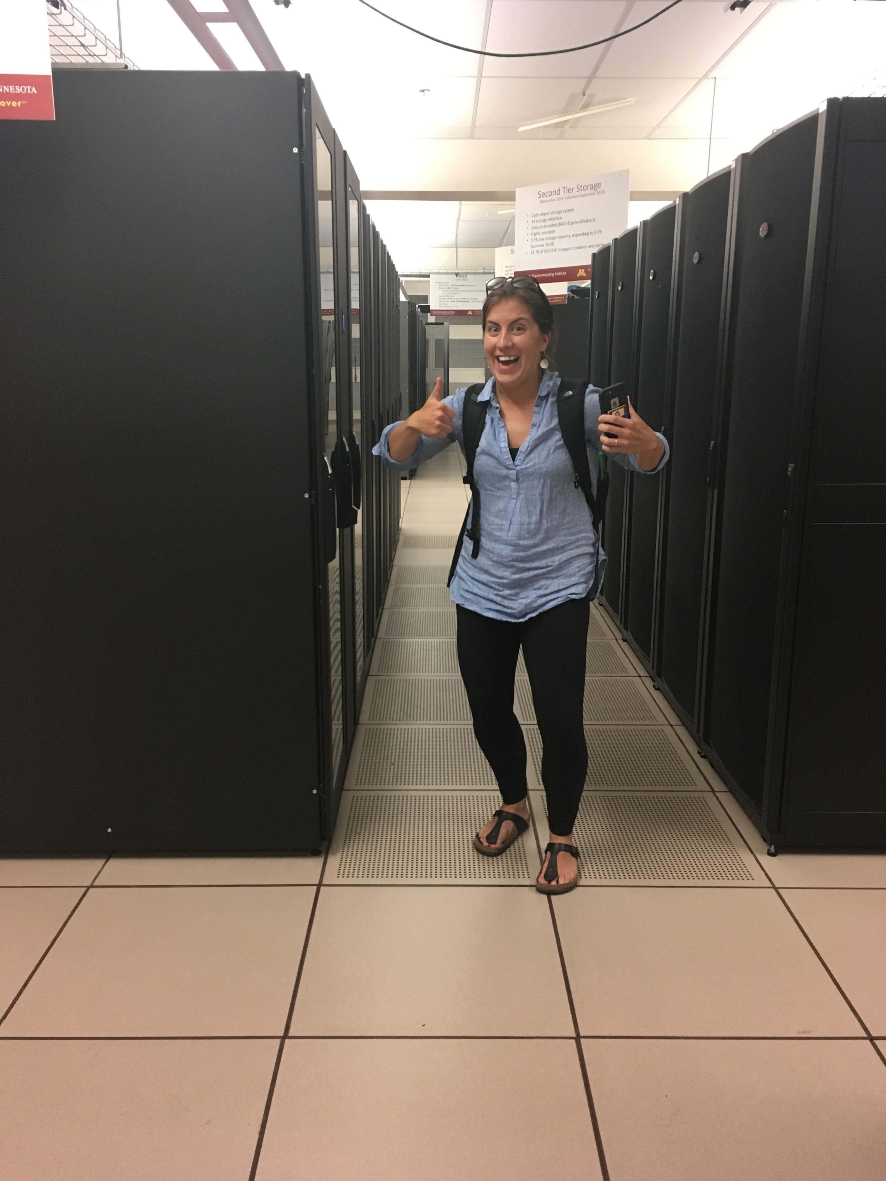
In reality…

Slide 5
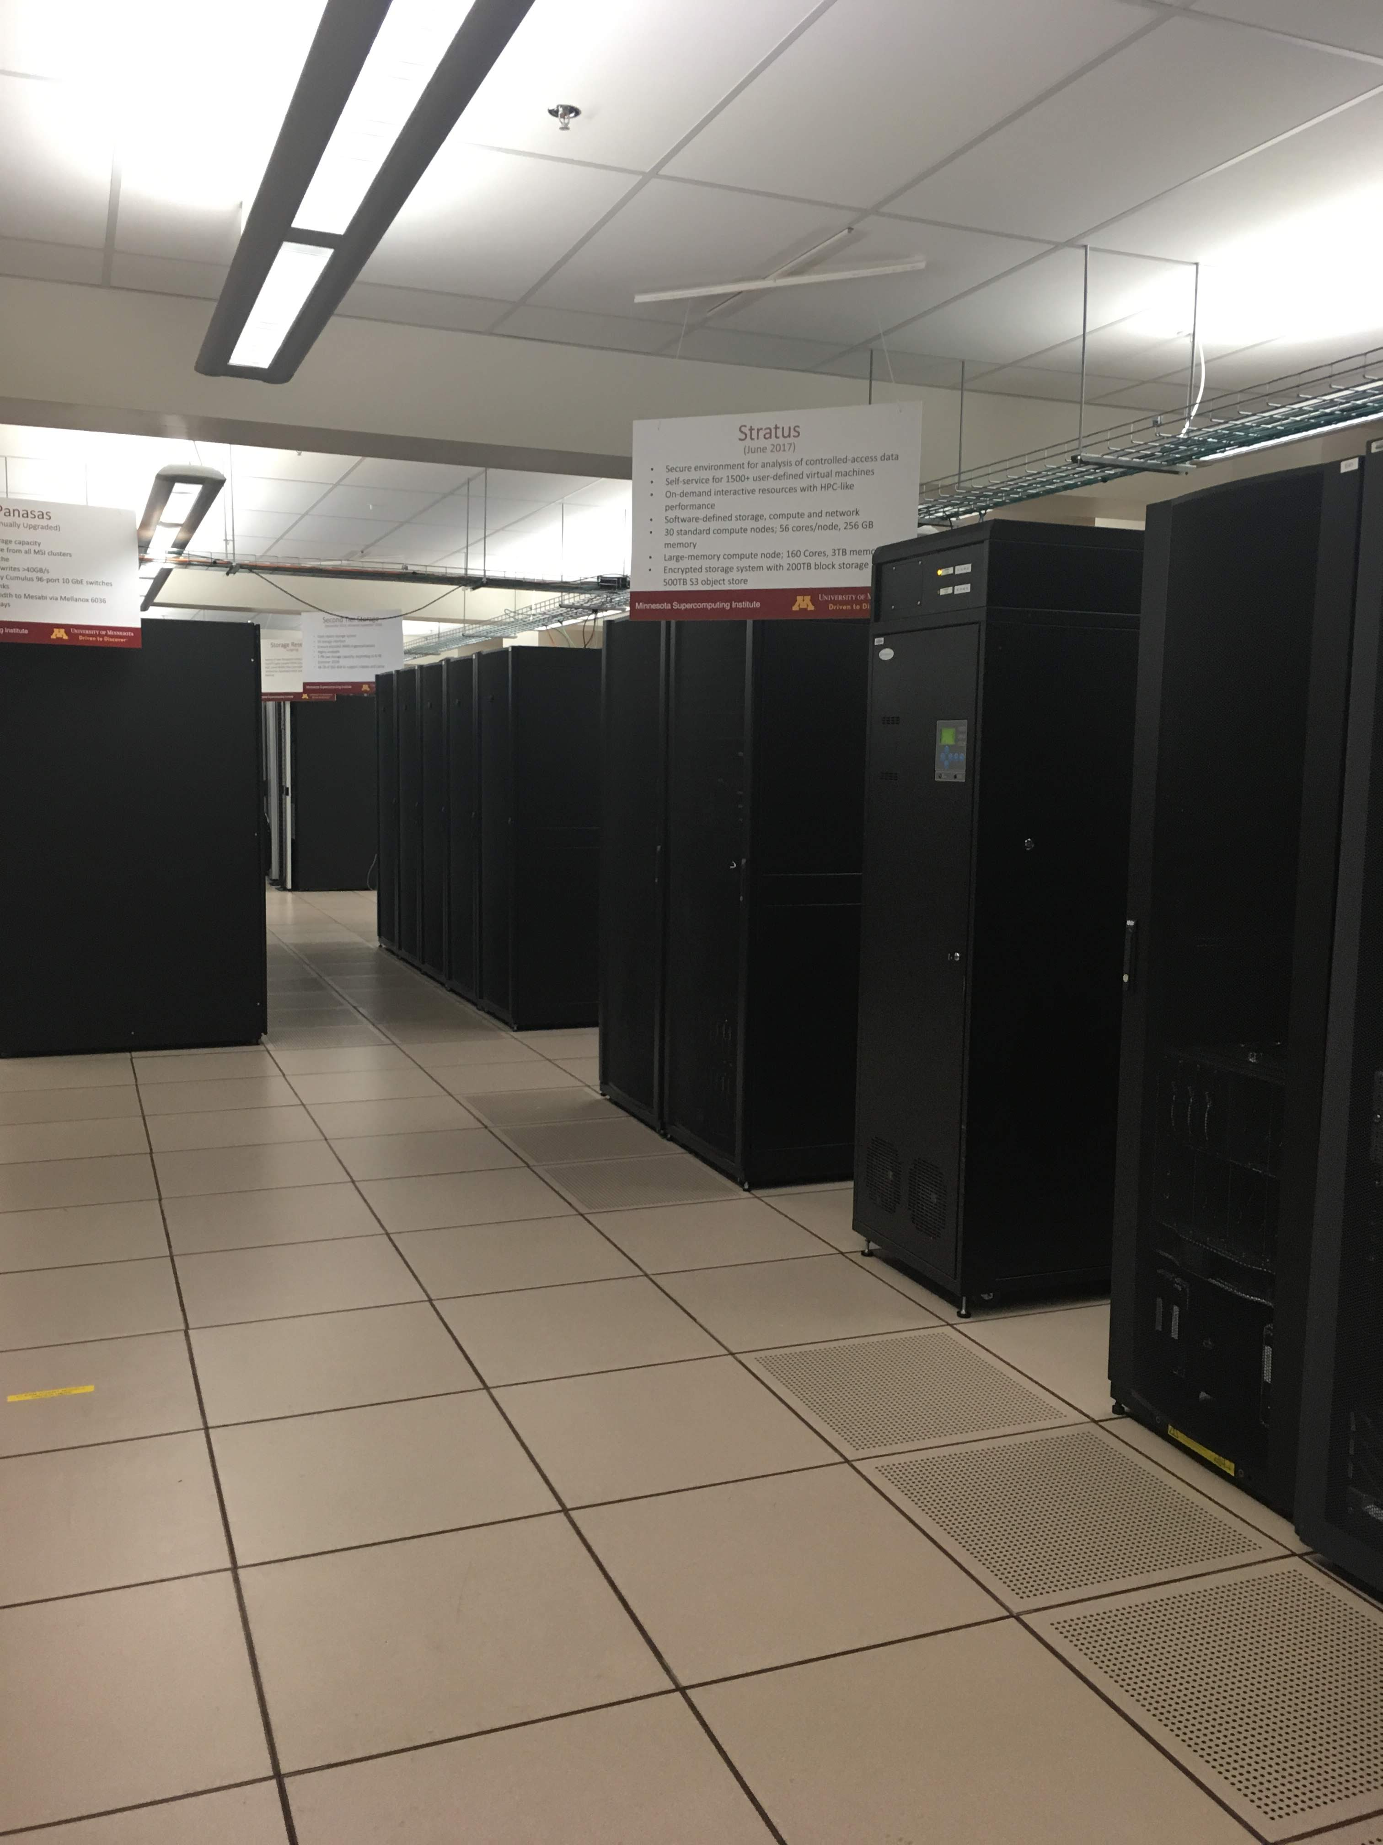
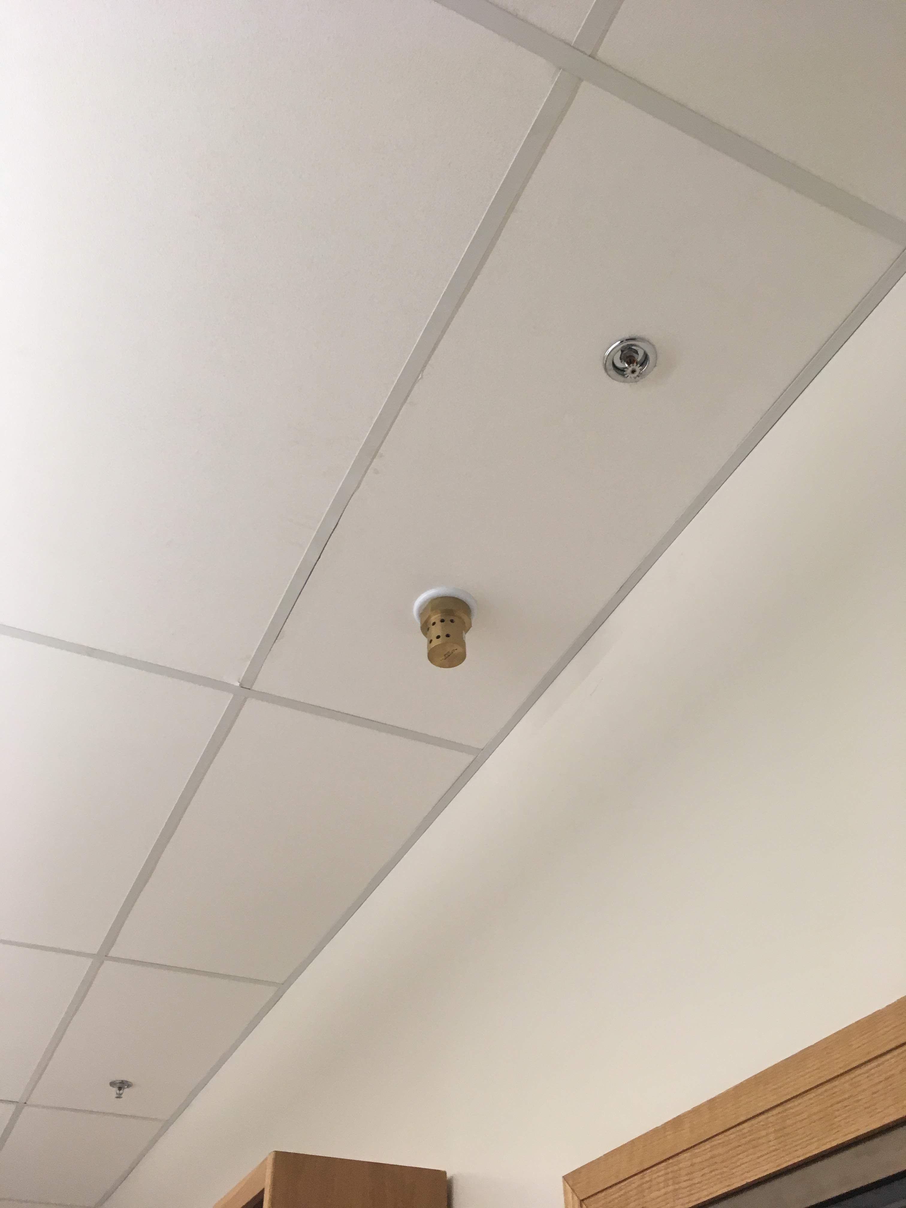

Slide 6
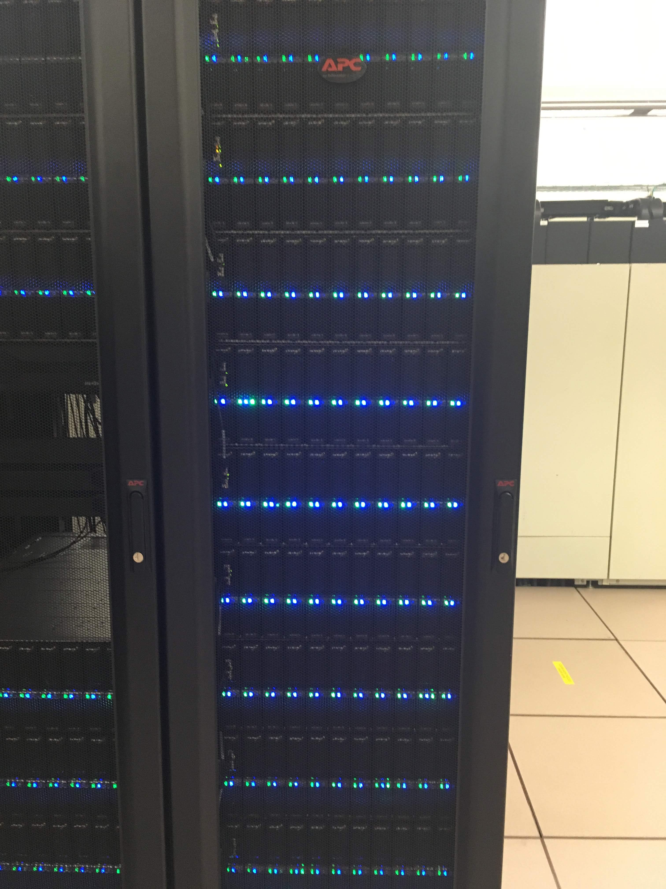
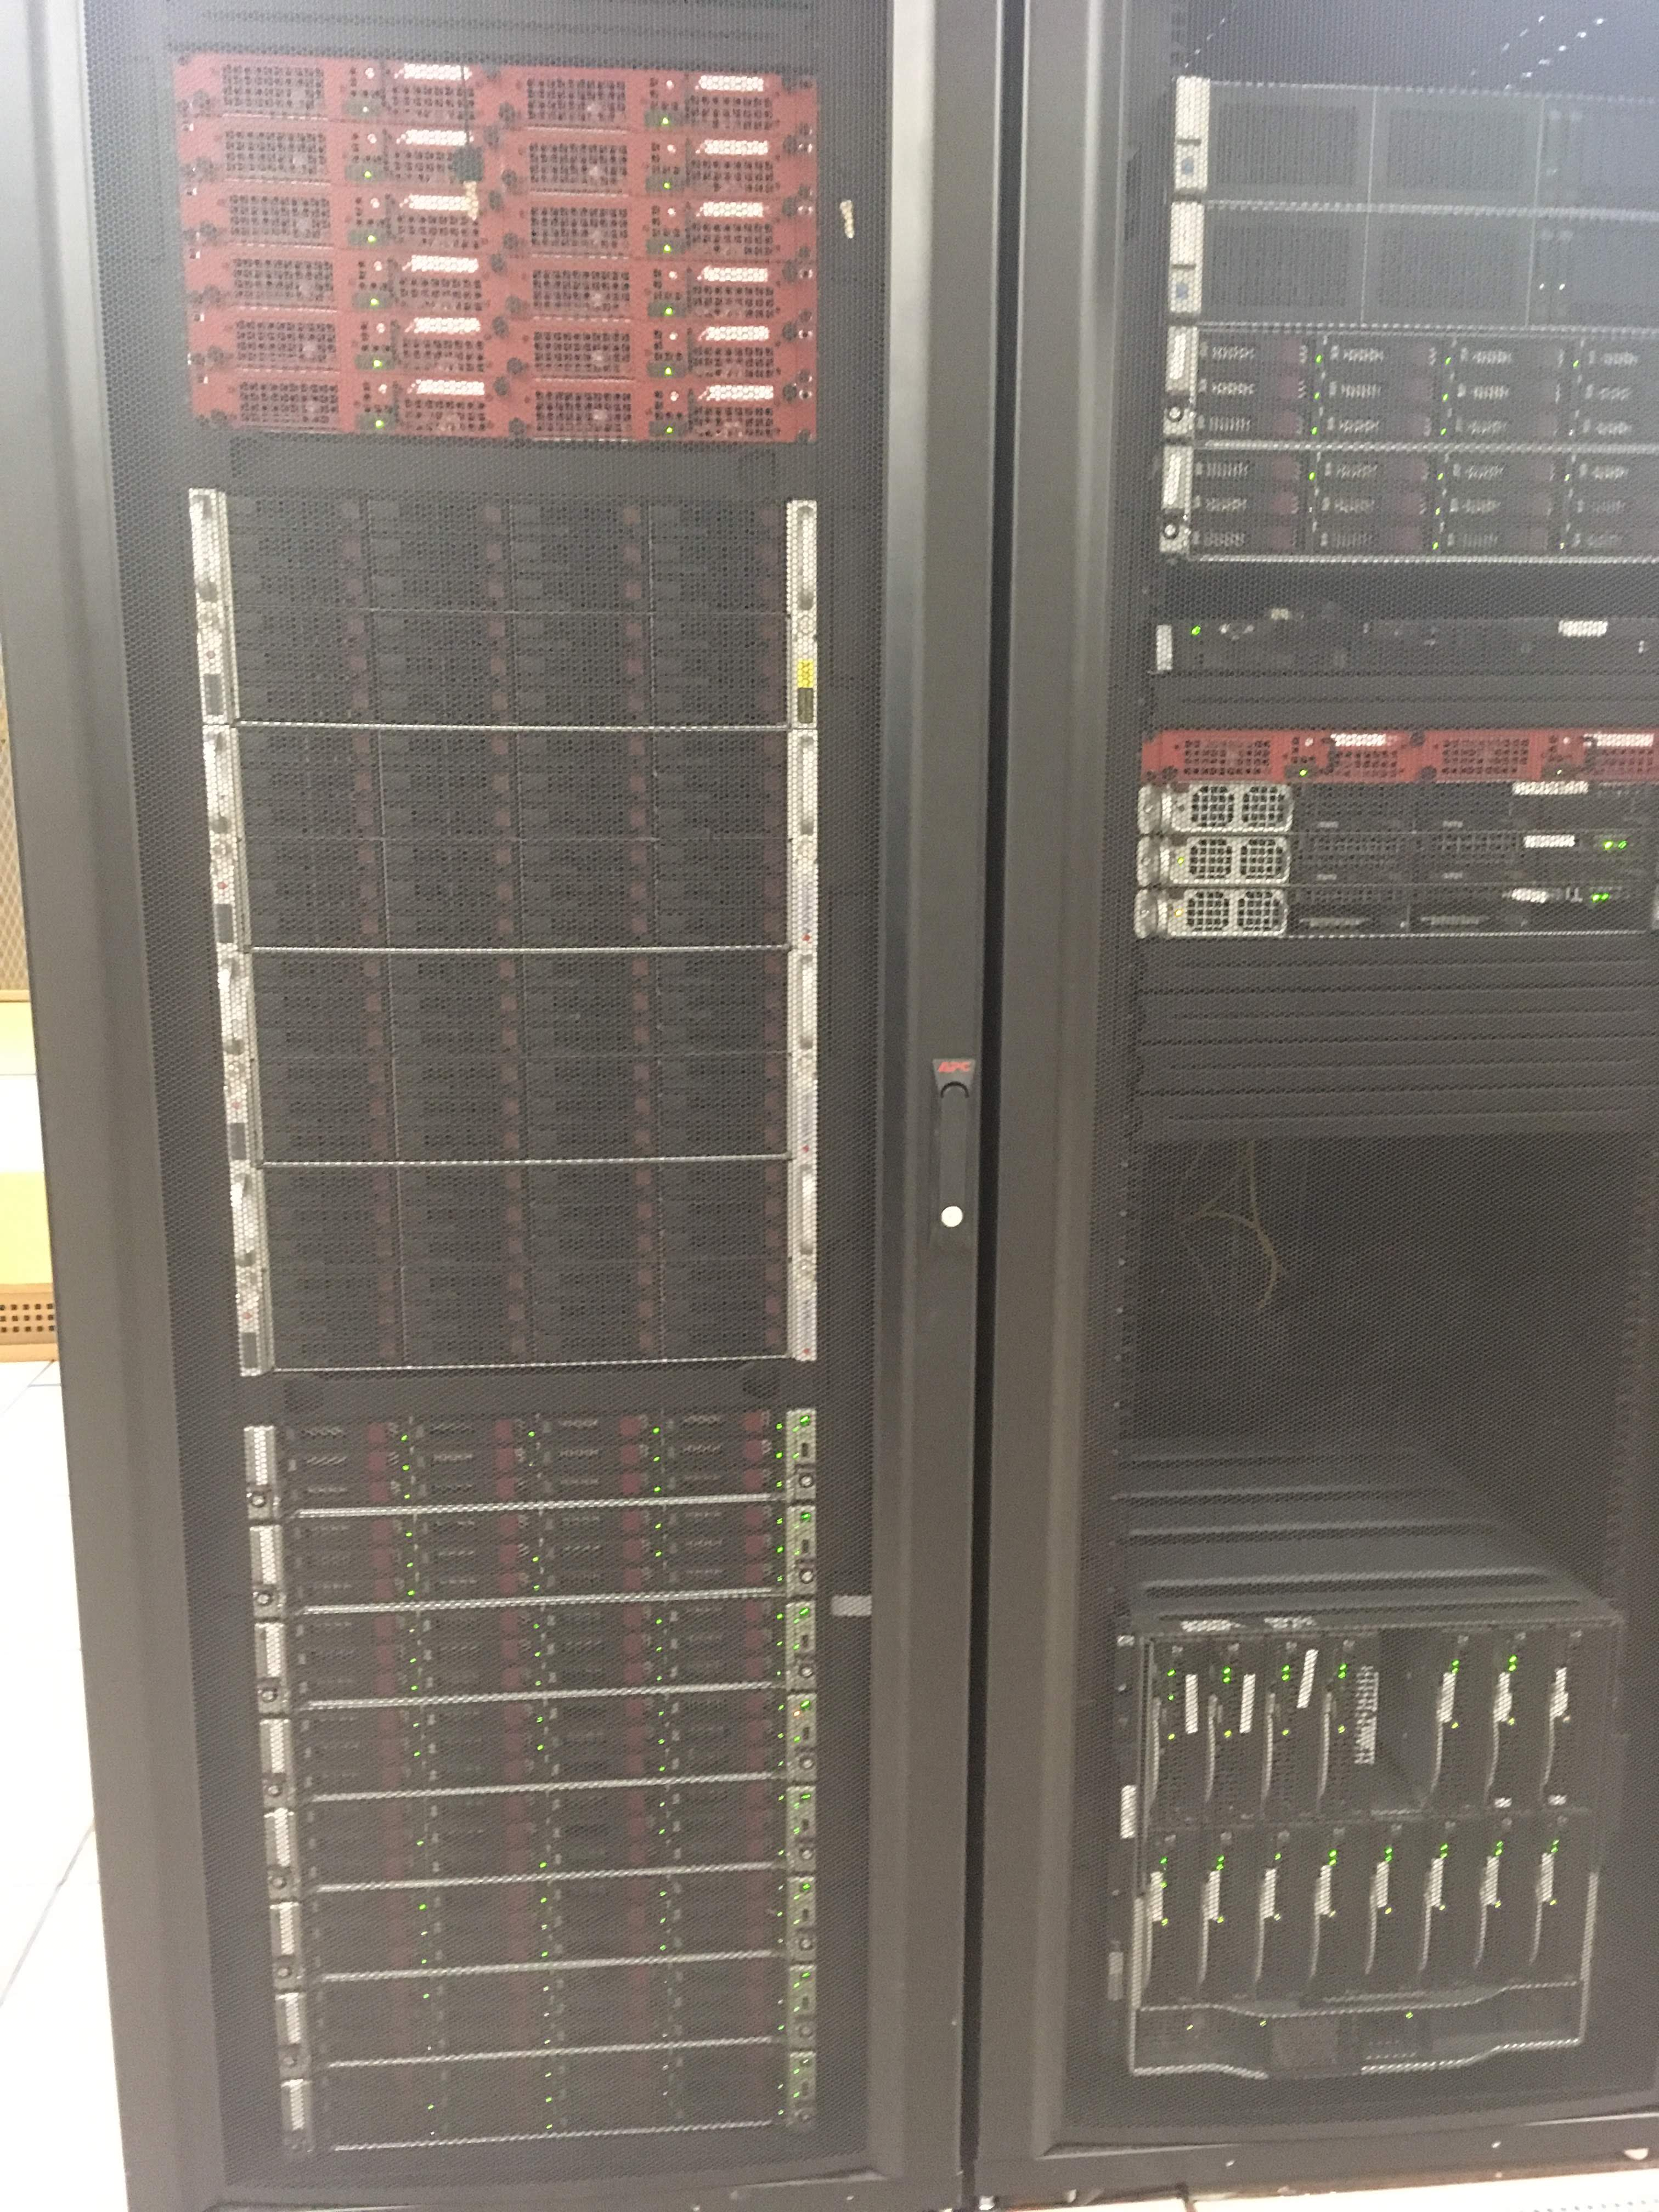

Slide 7

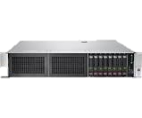
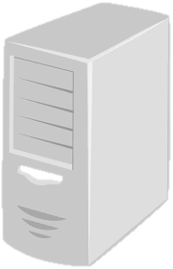
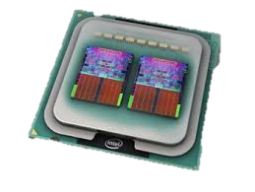
Nodes, servers, and cores! Oh my! (And clusters and CPU’s and jobs and threads and RAM and…)
YOU
CLUSTER
SERVER
NODE 1
NODE 2
NODE 3
CPU 1
Core 1
Core 2
CPU 1
CPU 1
Core 1
Core 1
Core 2
CPU 2
Core 2
Core 1
Core 2
Notes:
There’s a TON of terminology surrounding servers and clusters and HPC, etc… I am going to try to focus on the terms that you will probably have to actually deal with if you are going to run metagenomic analysis on your own. Here is a VERY BASIC diagram of a VERY SIMPLIFIED server architecture. Basically, the nodes are like individual computers, and they each contain some number of CPUs (central processing units). It used to be that one node = 1 CPU, but this is no longer the case. Within each CPU, there can be multiple “cores”. A ”core” can contain multiple threads, OR a ”job” (i.e., a computer task) can be “multi-threaded” across multiple cores, multiple CPUs, and even multiple nodes. Many Universities have so-called “clusters”, which are basically a conglomeration of nodes (often of different sizes). Another thing to consider is the amount of RAM available on a given node. Some applications require large amount of RAM on a single node, whereas others can be broken up across multiple, smaller nodes.

Slide 8
Just one example, from Ohio…
Image Source: https://www.osc.edu/resources/technical_support/supercomputers/oakley

Slide 9
Another example (from NYU):
done
Image source: https://wikis.nyu.edu/display/NYUHPC/Login+and+Compute+Nodes

Slide 10
Major challenge: Multiple users with multiple diverse jobs + LIMITED RESOURCES
done

Slide 11
Major challenge: Multiple users with multiple diverse jobs + LIMITED RESOURCES
done
One solution == JOB SCHEDULERS (“the queue”)

Slide 12
How much “compute power” does my job require?
Considerations:
Runtime?
Parallelization? (of entire pipeline vs. components of pipeline)
Number of samples and linear vs. non-linear time?

Slide 13
We will re-visit these themes during the hands-on portion of the workshop…coming soon!

Slide 14
What about Amazon (“The Cloud”)?

Slide 15
Image Source: http://www.conceptdraw.com/How-To-Guide/aws-icons-2
Notes:
Amazon Web Services is HUGE….it encompasses many, many different applications. We are goign to just focus on the application that we will use today, called Amazon EC2.

Slide 16
Notes:
Basically, we are using Amazon’s physical equipment to set up our own server, with our own software and programs and data installed.

Slide 17
Image Source: https://www.slideshare.net/harishganesan/architecture-mobile-cloud-computing-aws-ec2

